Slide 1
Lecture No. 16 Metal Finishing
At the end of this lecture, student will be able to:
Identify the differences between electroless plating and electroless plating
Electroless plating of copper with specific relevance to PCB
Electroless plating of Nickel

Slide 2
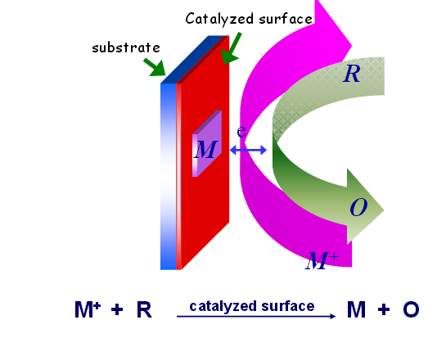
Electroless Plating
Depositing a metal or alloy over a substrate (conductor or nonconductor) by controlled chemical reduction of the metal ions by a suitable reducing agent without using electrical energy
Metal ion + Reducing agent → Metal+ Oxidized product
Also termed as autocatalytic plating

Slide 3
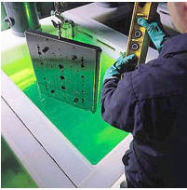
Electroless Plating
Surface to be plated should be catalytically active
Catalytic metals like Ni, Co, Steel, Pd etc., do not require any surface preparation
Non catalytic like such as Cu, brass, Ag etc., need activation
Done by dipping in palladium chloride solution

Slide 4
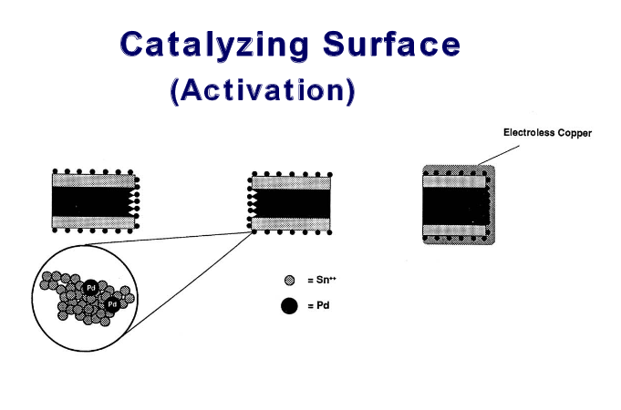
Electroless Plating
Non conductors like glass, plastics, etc., are first activated in a solution of SnCl₂ and HCl
After rinsing its immersed in a solution of PdCl₂ and HCl
Treatment yields a thin layer of Pd on the treated surface

Slide 5
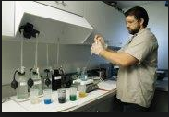
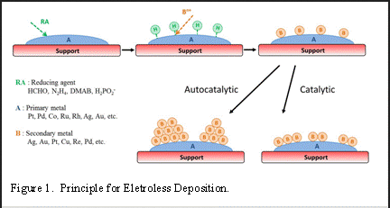
Composition of Electroless bath
Soluble salt of the metal to be plated
Reducing agent
Buffer for pH control
Complexing agent
Stabilizer is added to prevent decomposition of plating bath
Accelerator to increase the rate of plating

Slide 6
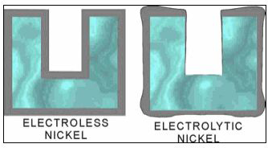
Advantages of Electroless Plating
No electrical energy is required
Better throwing power
Plating on articles made of insulators and semiconductors
Electro less plated coatings possesses unique mechanical chemical properties

Slide 7
Electroless Plating of Copper
Composition of bath:
Coating solution | CuSO₄ solution (12g/l)
Reducing agent | HCHO (8 g/l)
Buffer | NaOH (15 g/l) and Rochelle salt(14g/l)
Complexing agent | EDTA di sodium salt (20g/l)
Optimum pH | 11
Optimum temperature | 25⁰C
Reactions:
Cu²⁺ + 2e -----------> Cu (Cathode)
2 HCHO + 4OH⁻ ------> 2HCOO⁻ +2H₂O + H₂+ 2e (Anode) ----------------------------------------------------------------
Cu ²⁺ + 2HCHO + OH⁻ -----> 2HCOO⁻ +2H₂O + H₂ + Cu
----------------------------------------------------------------

Slide 8
Applications Electroless Plating of Copper
Used for metalizing printed circuit boards
For producing through-hole connection necessary when double sided printed circuit boards are fabricated
For plating on non conductors

Slide 9
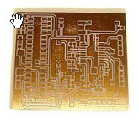
Printed Circuit Board (PCB)
Three methods of fabrication of PCBs: PCB Copper Plating
Subtractive process
Semi additive process
Additive process
Printed circuit boards are made of epoxy polymers, phenolics or any other thermally stable rigid polymers
Flexible films of polyesters and polyamides are also used
Making a Double Sided PCB with Plated Vias

Slide 10
Printed Circuit Board (PCB)
Two sides of a plastic board is electro-less plated with copper
Circuit is printed on the board using an enamel and dried
Board is dipped in acidified ferric chloride which etches away copper leaving the circuit drawn portion
Enamel is removed using a solvent
Thus two circuits are produced on two sides
Connection between two sides is made by drilling hole followed by plating through-holes by electroless plating
Inner Layer Imaging -- PCB Manufacturing

Slide 11
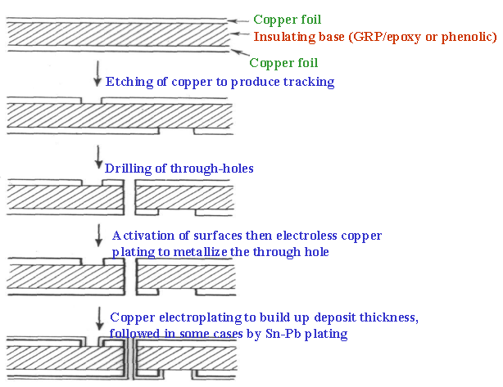
Subtractive Technique for the Manufacture of Printed Circuit Boards

Slide 12
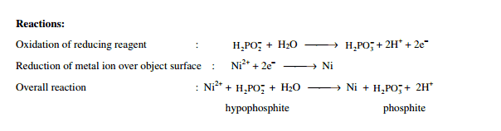
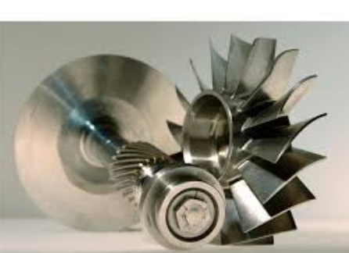
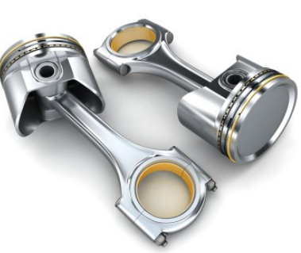
Electroless plating of Nickel
Plating bath solution | NiCl₂
Reducing agent | Sodium hypophosphite
Complexing agent | Sodium succinate
Buffer (p^{H} = 4.5) | Sodium acetate
Temperature | 93 ºC

Slide 13
Major Drawbacks
Costs more/unit weight of the deposited metal
Requires pure chemicals
Chemical reductants are more expensive than electricity
Metal salts and reductant used in electro less plating solutions are thermodynamically not stable
Impurities or dust or colloidal matter even if present in trace amounts promote decomposition of bath components

Slide 14
Difference between Electroplating and Electroless plating
Property | Electroplating | Electrolessplating
Driving force | Electrical energy | Auto catalytic redox reaction
Site of cathode reaction | Substrate or object | Substrate with catalytically active surface
Anode | Separate anode | Substrate, No separate anode
Reducing agent | Electrons | Chemical reagents
Throwing power | Low | Good
Application | Only to conductors | Both to conductors and non conductors
Plating through holes | do not produce good deposit | produce good deposit

Slide 15
Summary
Process of electroless plating: Depositing a metal or alloy over a substrate (conductor or nonconductor) by controlled chemical reduction of the metal ions by a suitable reducing agent without using electrical energy
Electroless plating of copper with specific relevance to PCB: Activation of surface is done by dipping in SnCl₂ and PdCl₂
Electroless plating of Nickel: Gives hard and corrosion resistant metal finishing
Comparison between electroplating and electroless plating

